Slide 1
Video Game Industry
1983 -2015
Christopher Angeles

Slide 2
DESTINATION SOFTWARE
Destination Software is an American video game publisher, most known for their killer app Snood in 1996.
They are looking for market trends in and outside the US
Dataset obtained from Data.World - Video Game Sales in Volume 1983-2017

Slide 3
OBJECTIVES
01
02
03
04
VIDEO GAME INDUSTRY
Video game industry sales from 1983 - 2015
GLOBAL MARKET
Growth comparisons between various regions, global, NA, EU, & JP
PUBLISHERS
Top grossing publishers and their location of sales
GAMES/GENRE
Game genre popularity throughout NA, EU, & JP

Slide 4
TOOLS
03
04
01
02
MATPLOTLIB
Create various graphs using Python + MatPlotLib
PYTHON
PANDAS
Utilizing Pandas library to query, manipulate, and describe my data
Using python to search and analyze data
TABLEAU
Use Tableau to create graphs

Slide 5
VIDEO GAME INDUSTRY FACTS
UNITED STATES
2014 - 2015
2017-2018
LEADERS
CONSOLES
MAJOR SOURCE
US Gaming industry was worth 18.4b in 2017
The industry saw the largest growth of 8b from 2014-2015
In 2018, that number raised to 19.7b in the US
Sony
Microsoft
Nintendo
In 2019 install base reaching over 100M
(iPhone is 193M)
Two major sources for sales, hardware and software
Information obtained from Statistica.com

Slide 6
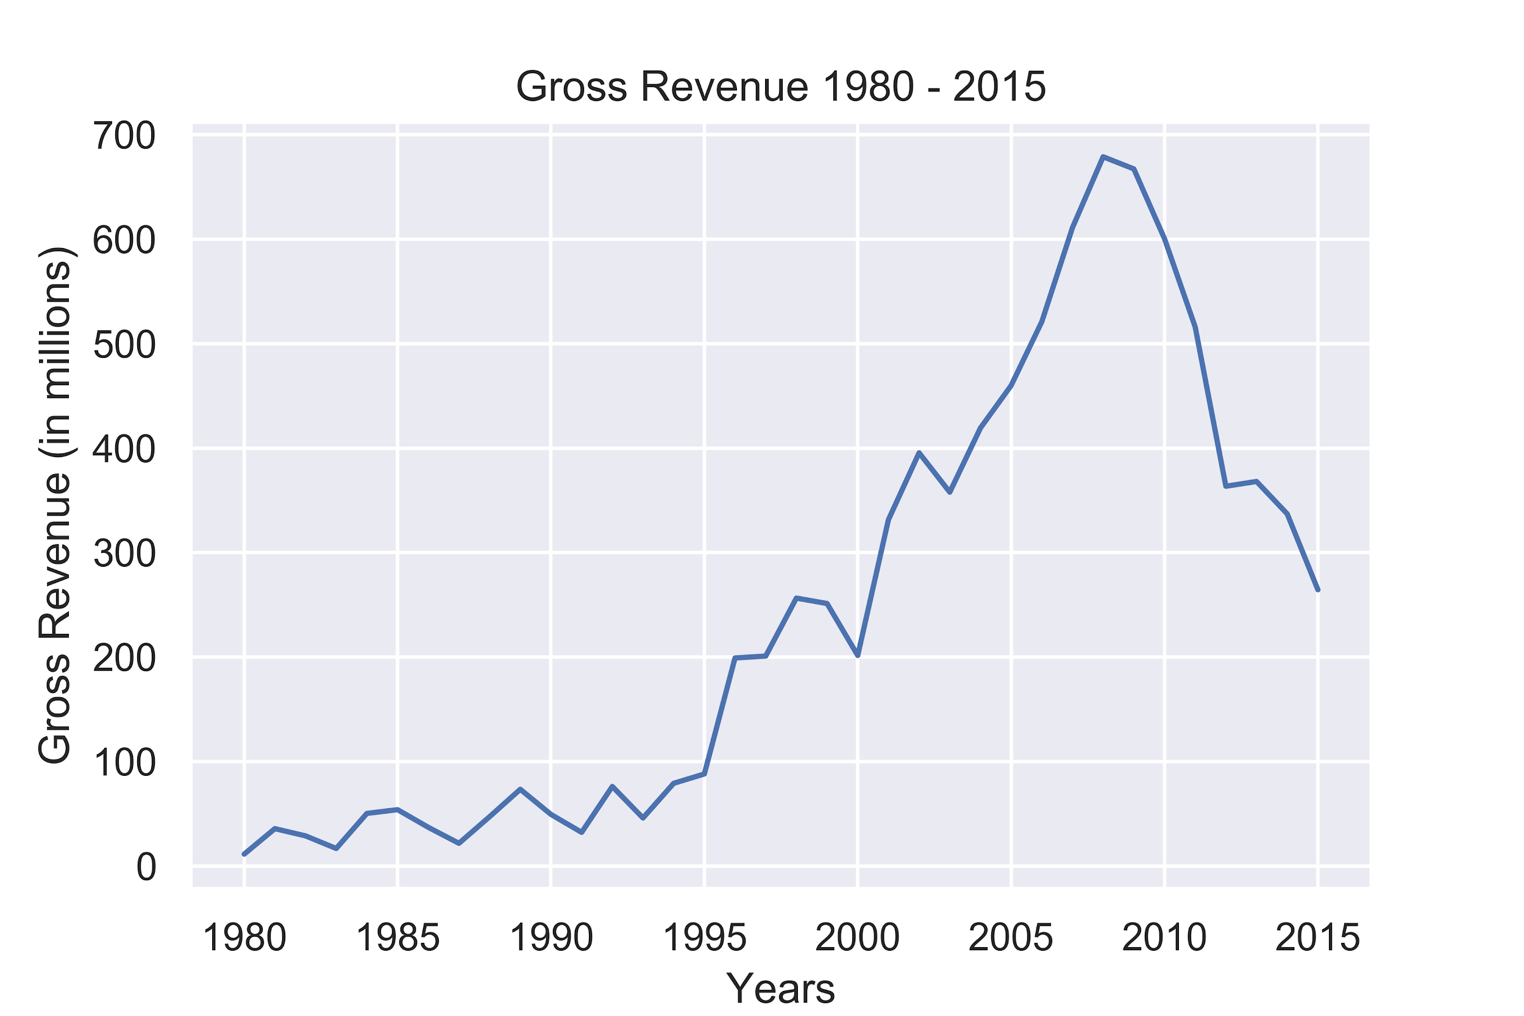
Global Gross Revenue 1983 - 2015

Slide 7
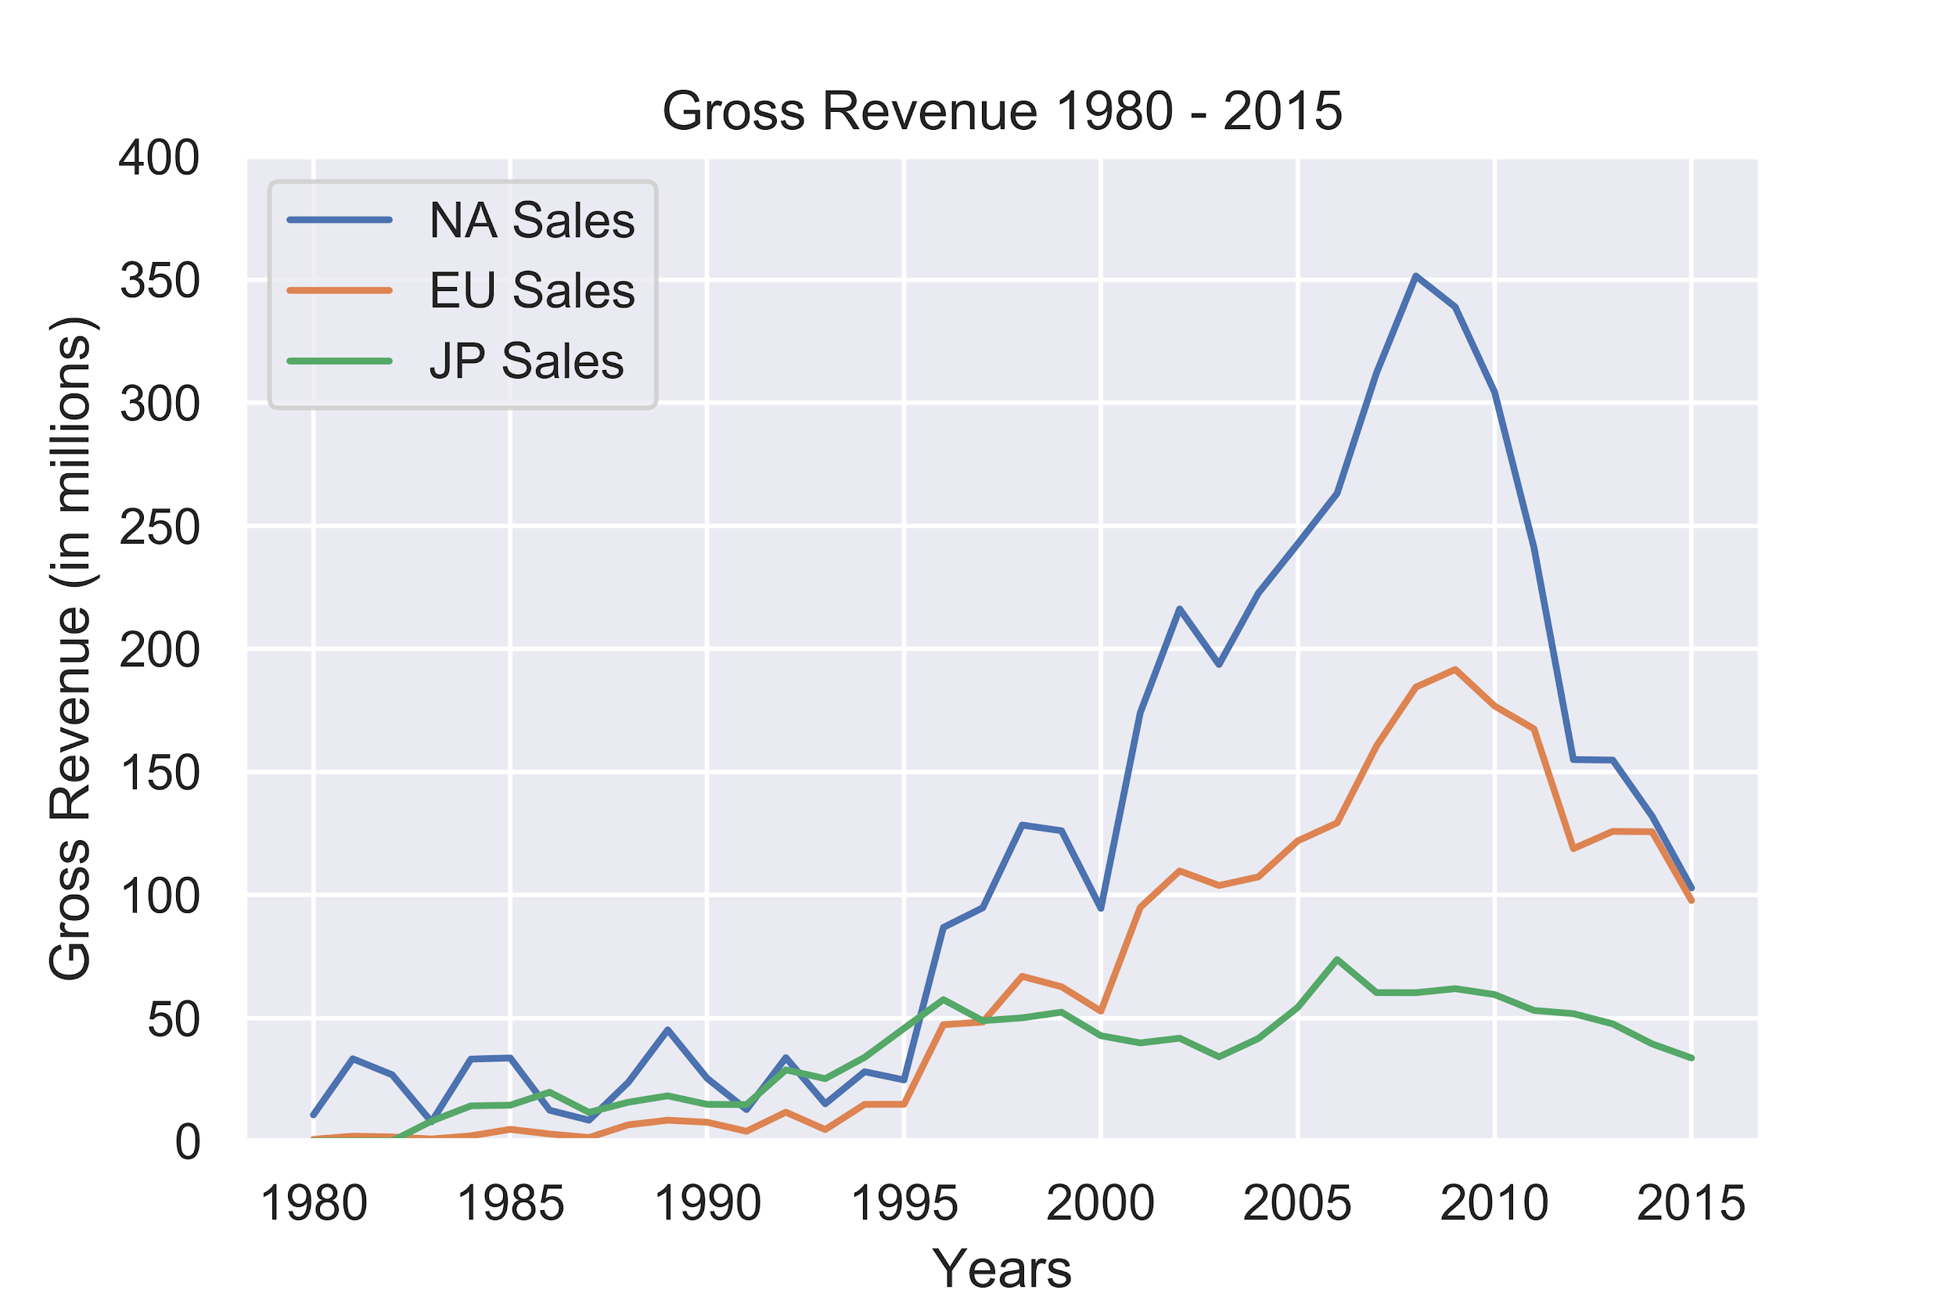
NA, EU, & JP Gross Revenue 1983 - 2015
North America has the largest market in sales, almost double that of EU sales, and magnitudes larger than Japan

Slide 8
ADDITIONAL FACTORS
PUBLISHER
PLATFORM
GENRE
INDUSTRY
More investments from publishers to make more games
Accessibility and install base can increase sale numbers
Trends in genre and types of games effect sale numbers
Changes in the industry can disrupt numbers, e.g mobile games

Slide 9
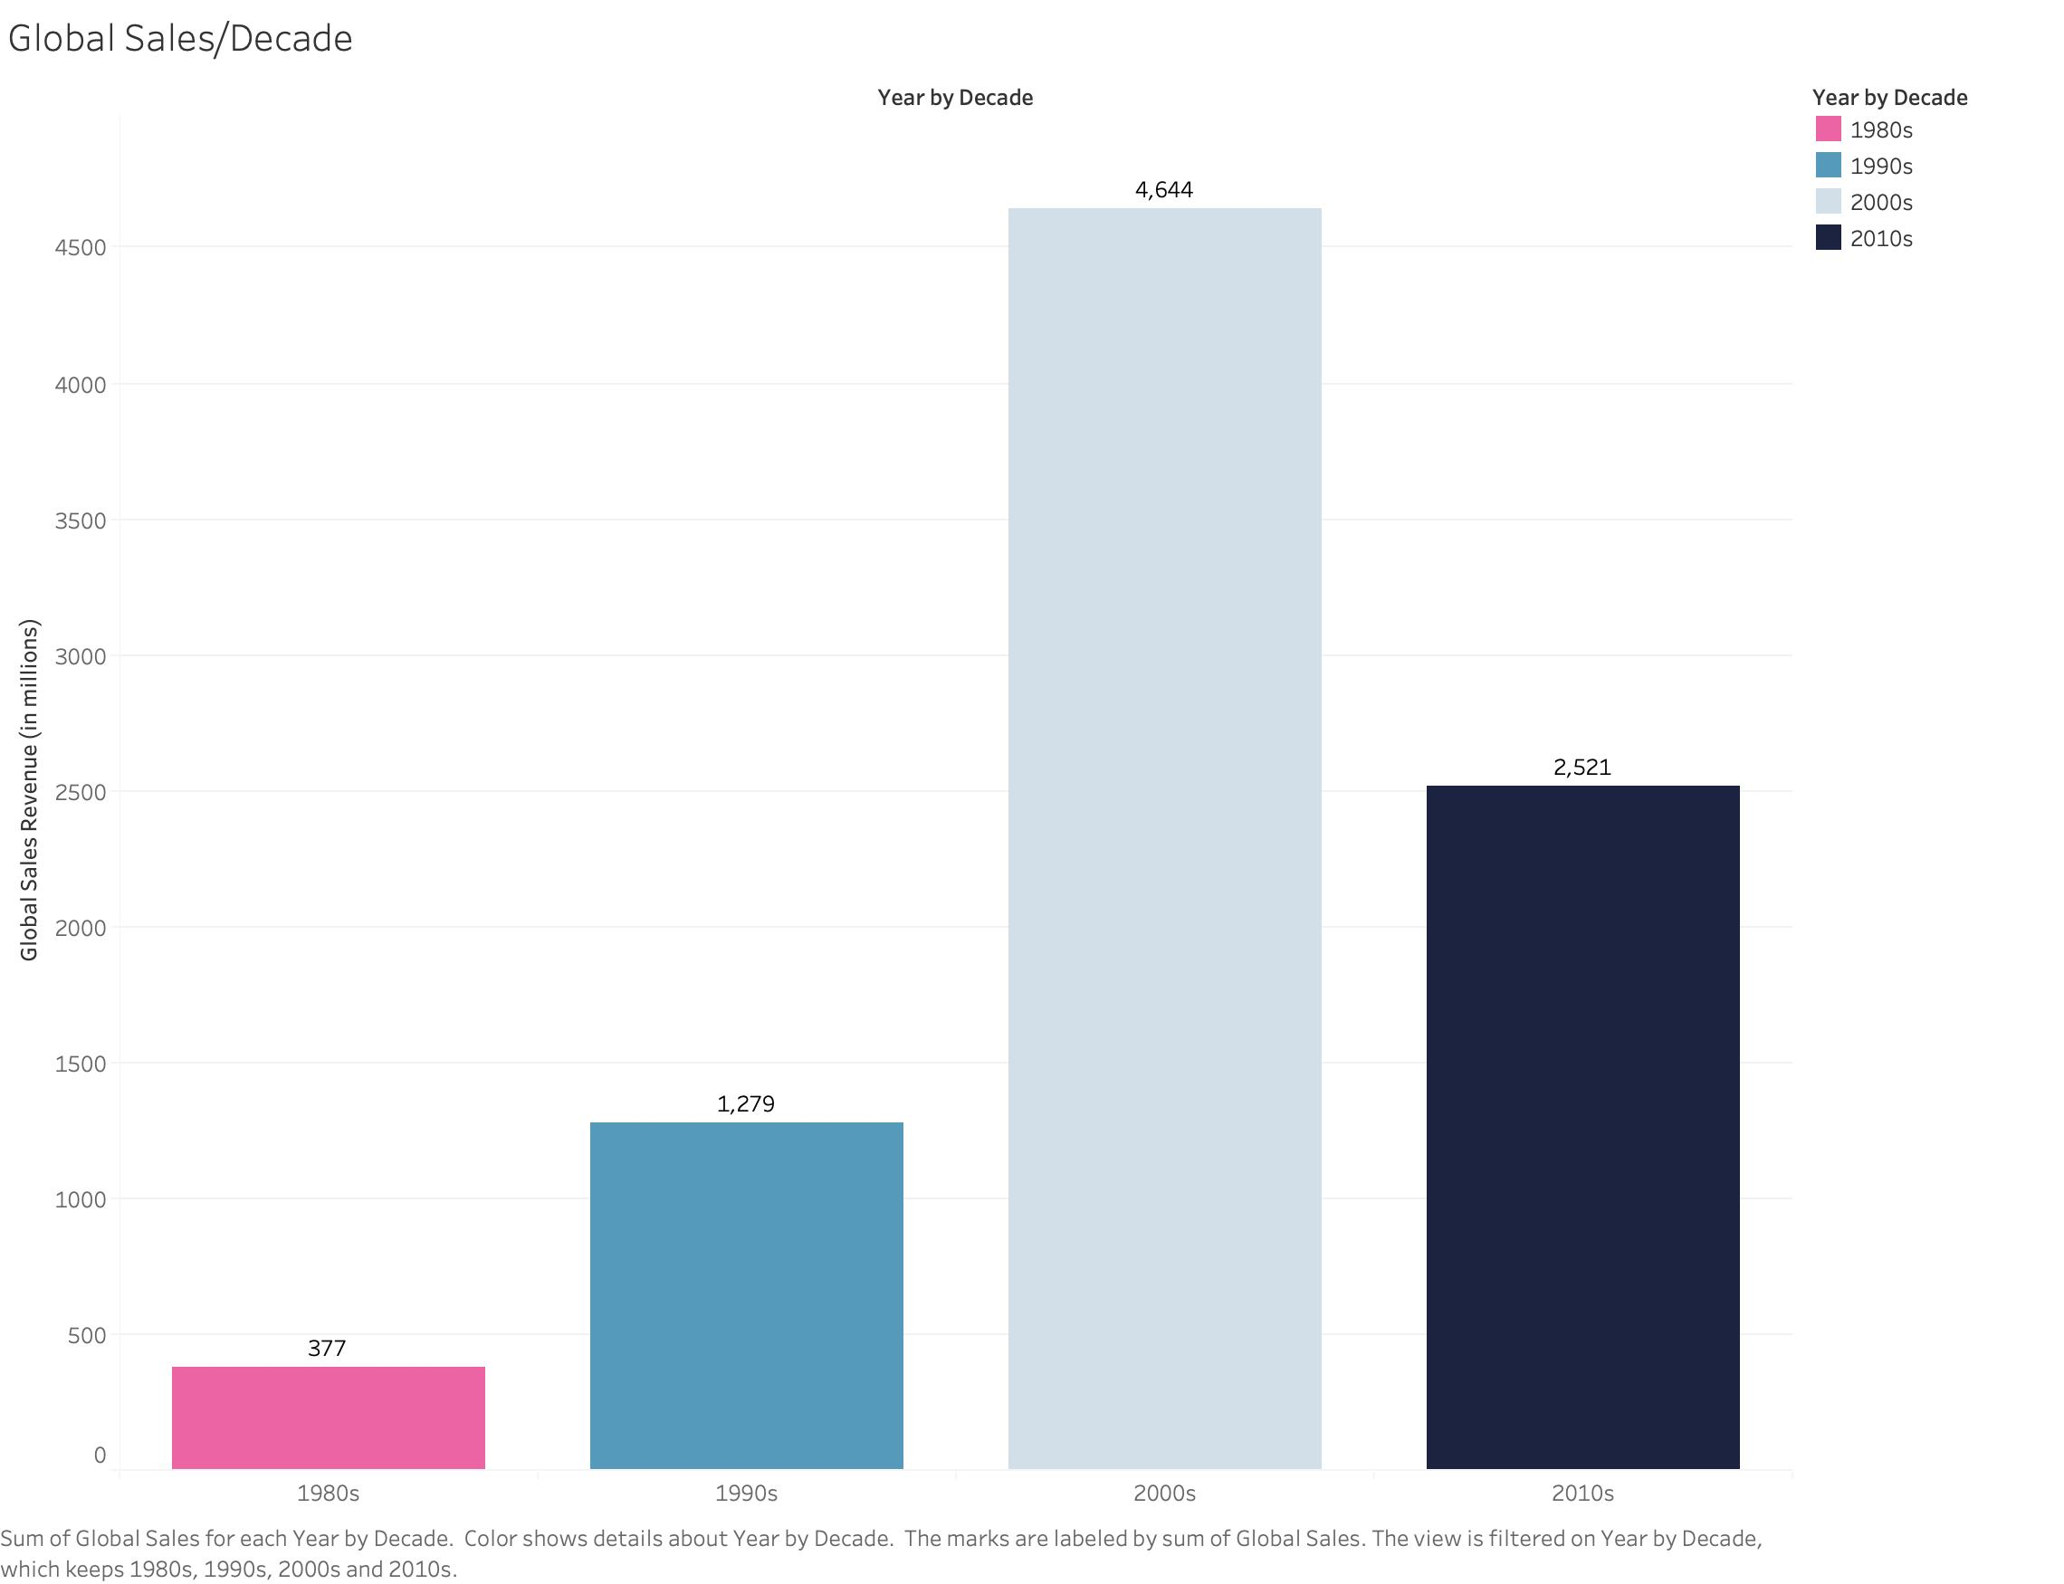
GLOBAL REVENUE BY DECADE
Four times increase in sales from the 90s to the 2000s, but a significant drop to the 2010s

Slide 10
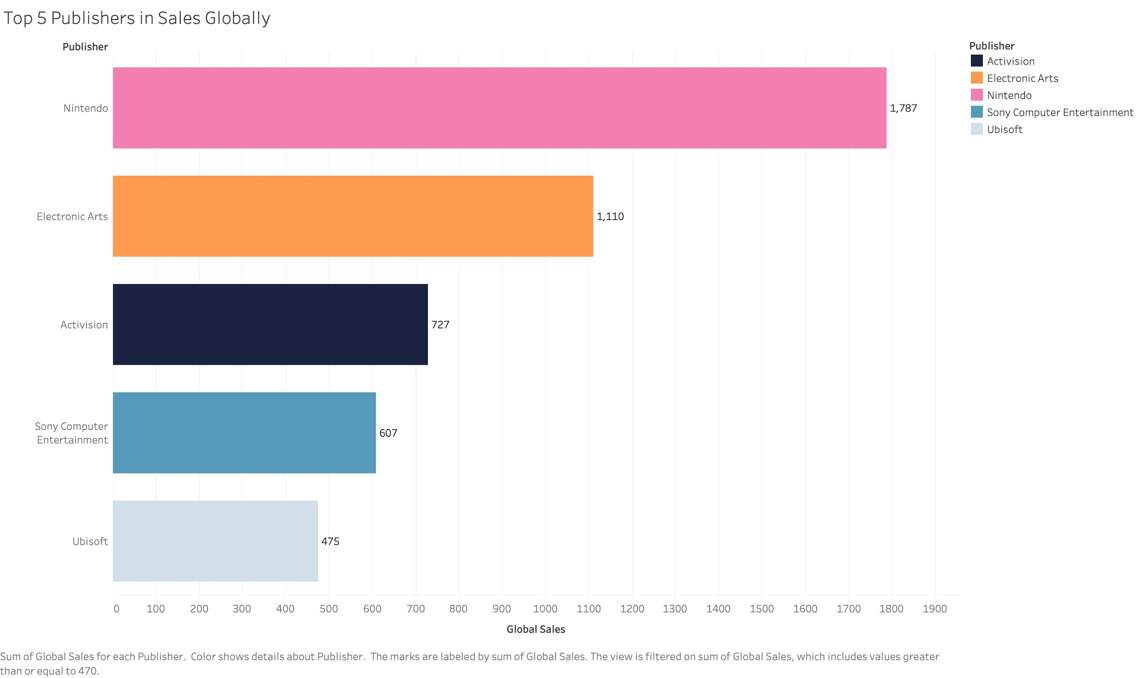
TOP PUBLISHERS IN VIDEO GAMES
Nintendo beats out the competition for highest sales amongst all publishers

Slide 11
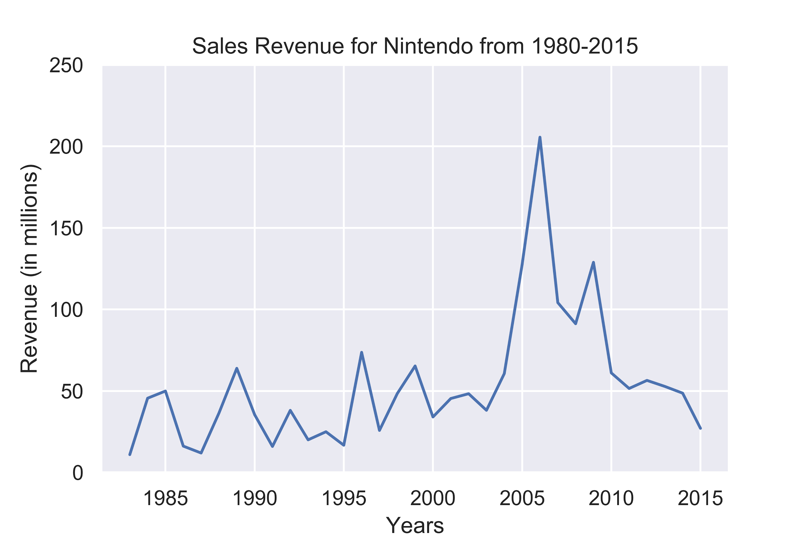
NINTENDO GLOBAL SALES REVENUE
Global sales for Nintendo remained steady until 2006, where it peaked at over 200 million in sales

Slide 12


Slide 13
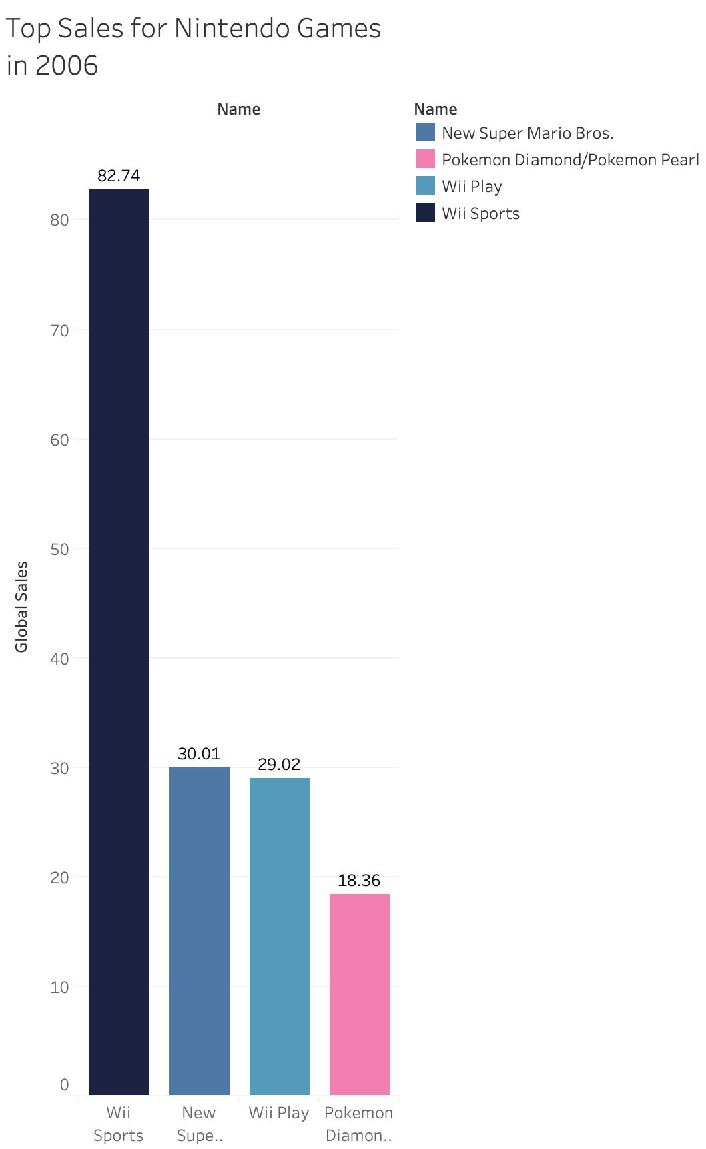
In Nov of 2006, Nintendo released the Wii along with an exercise game Wii Fit, grossing over 82m in revenue

Slide 14
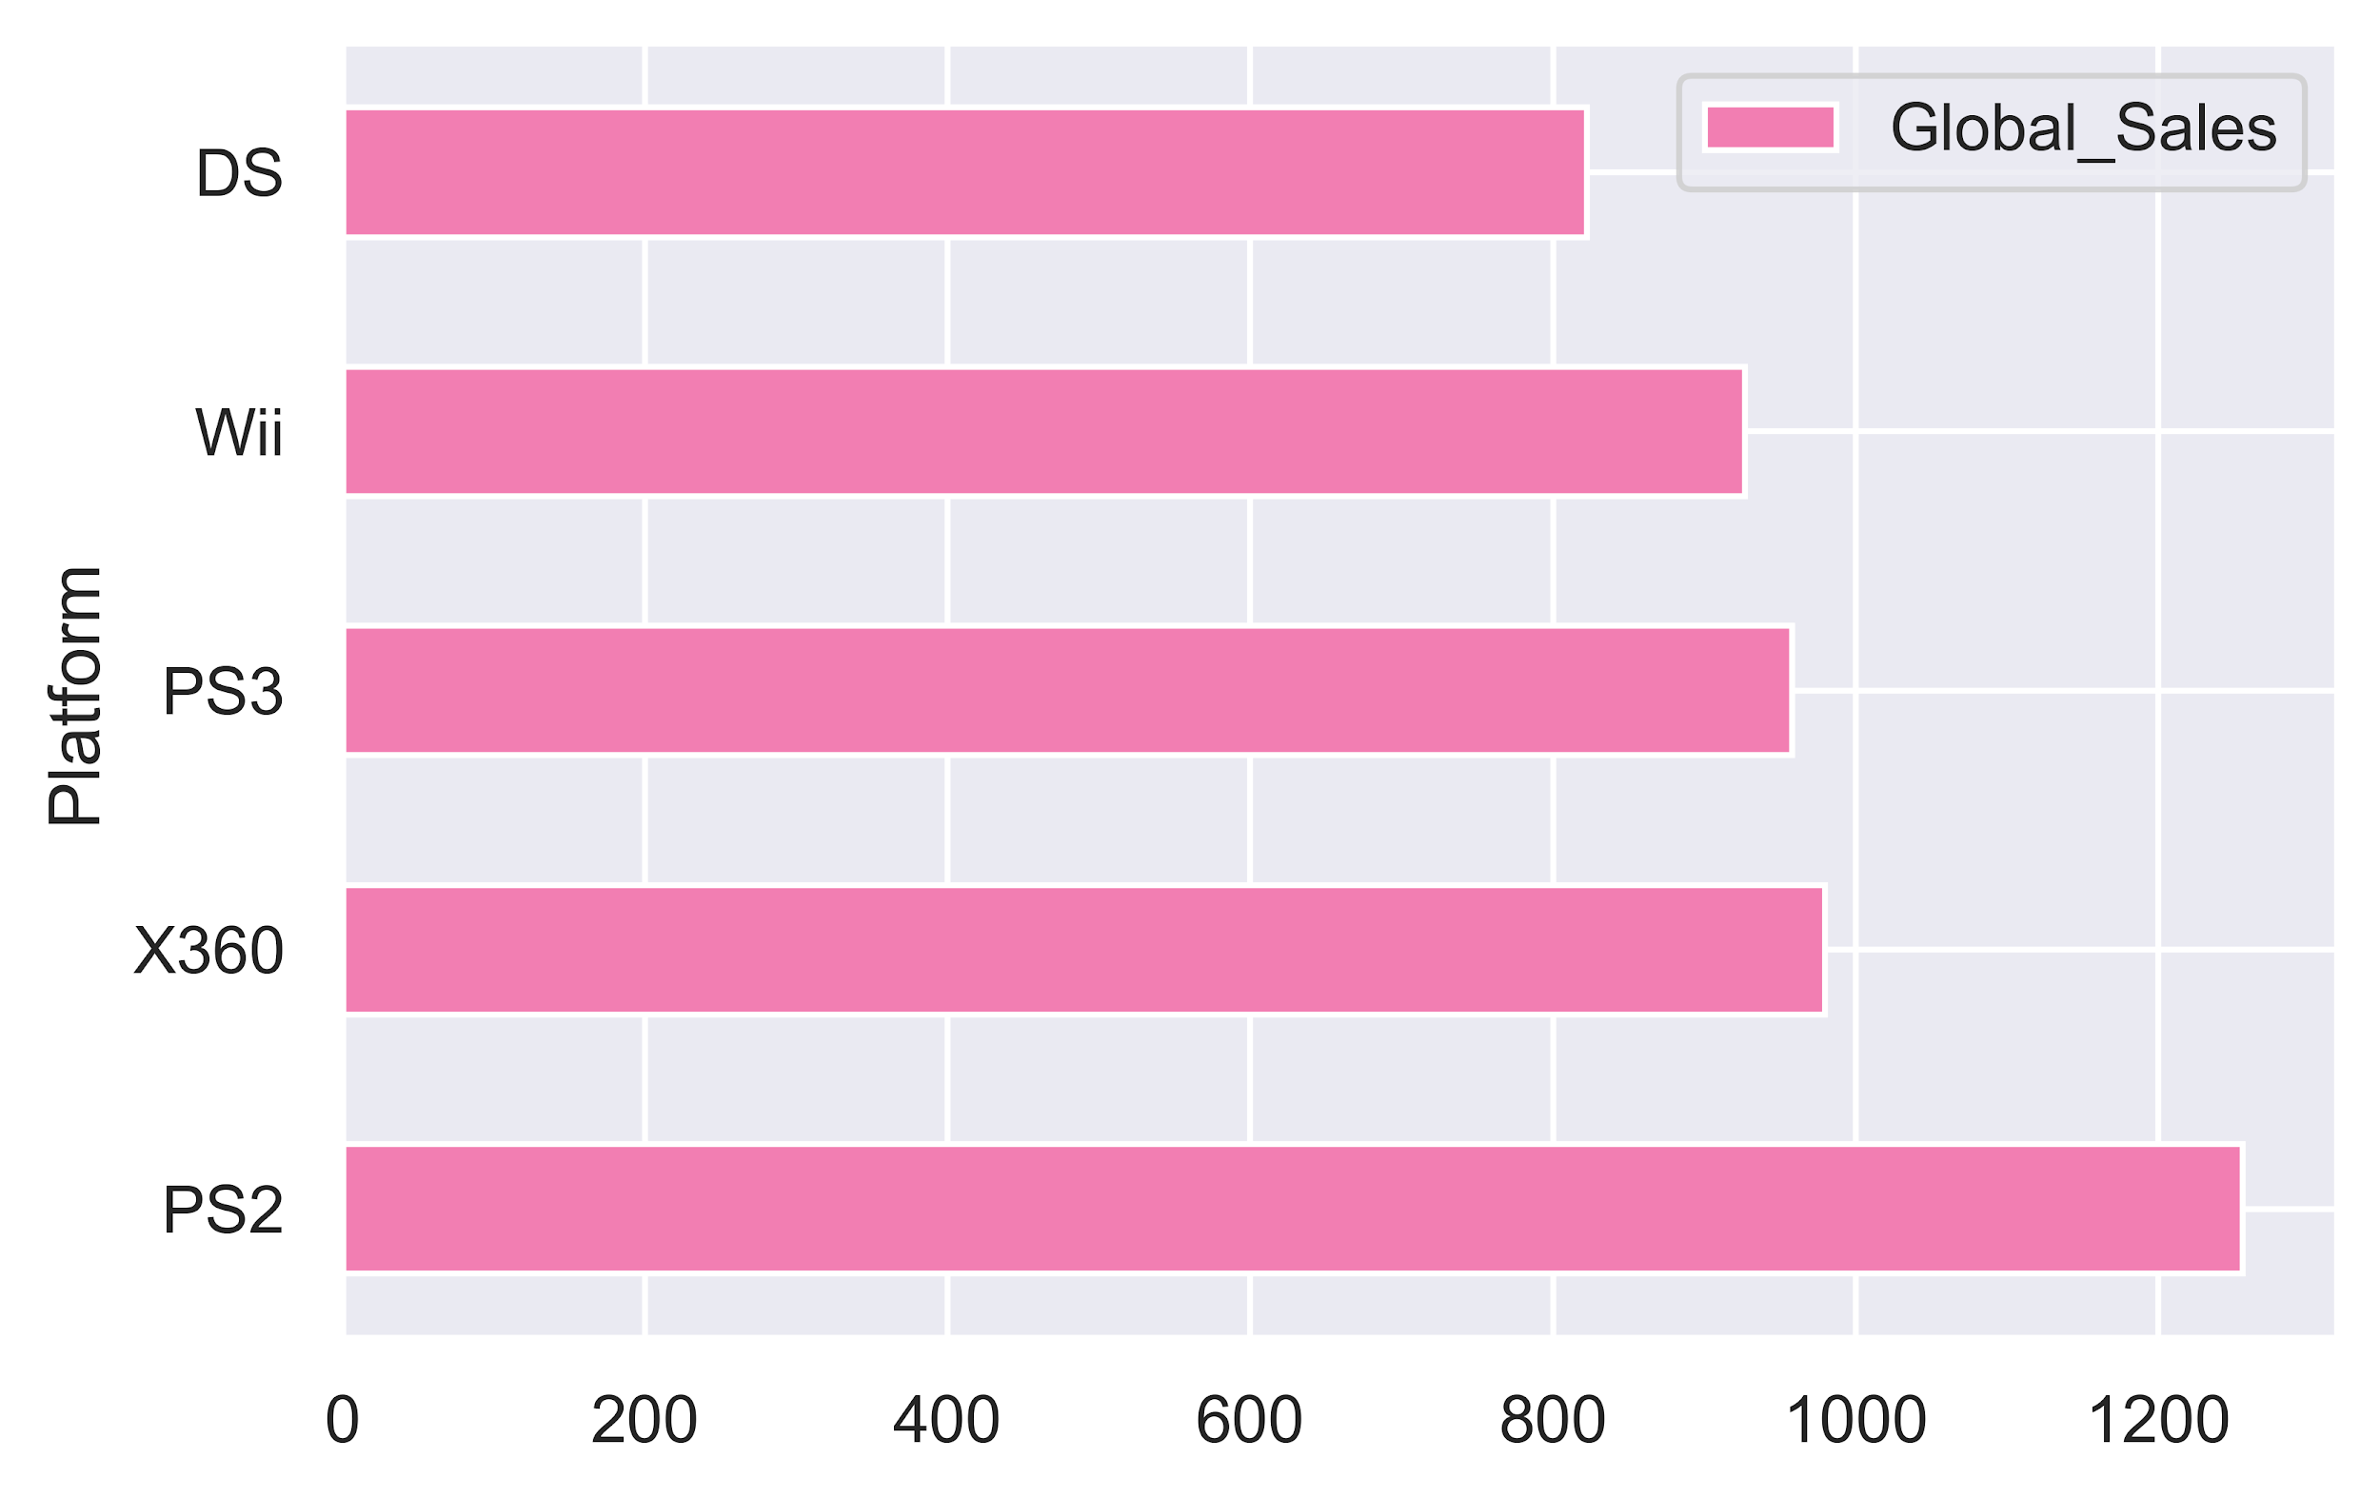
LET’S TAKE A LOOK AT THE CONSOLE IMPACT

Slide 15
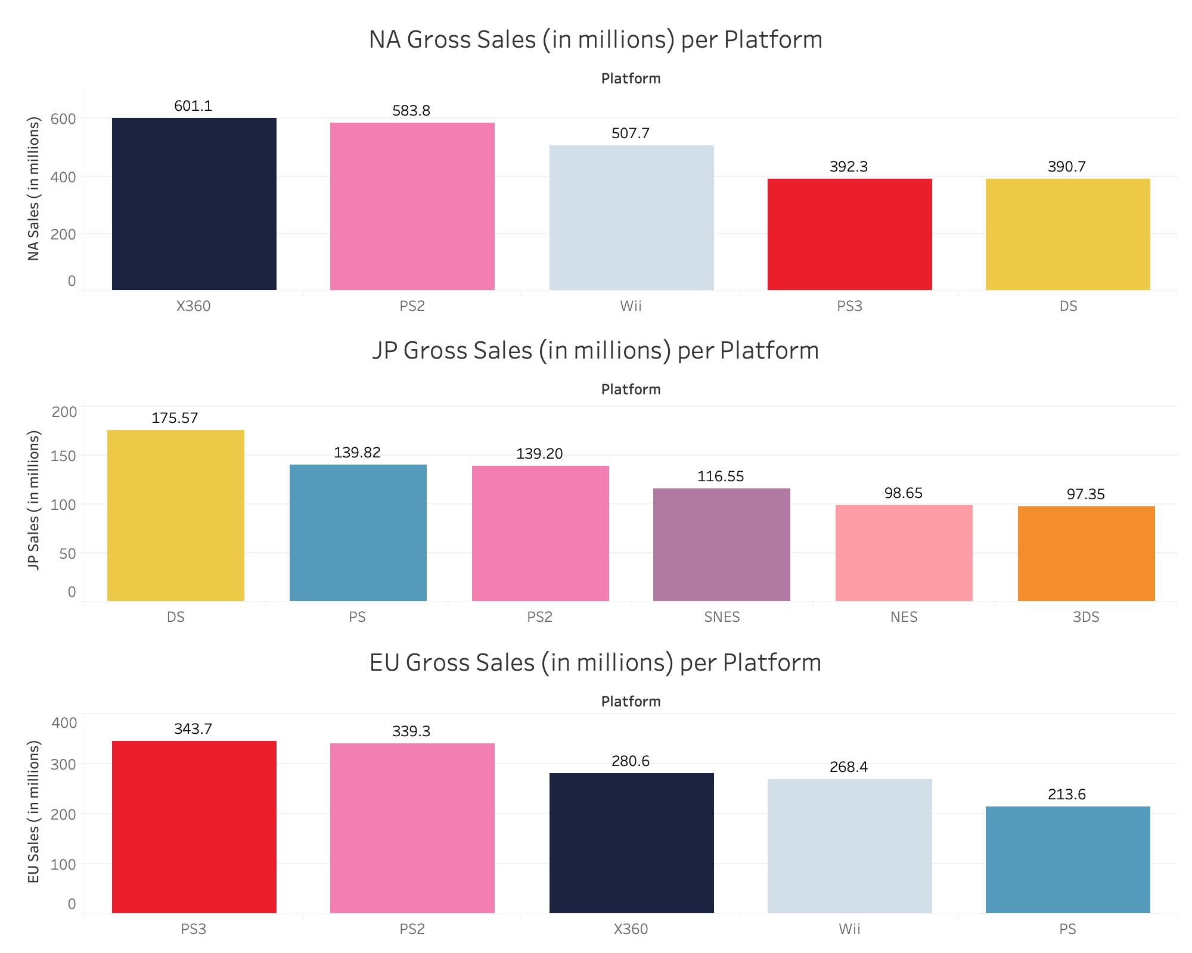
LET’S SPLIT UP THE SALES
Although xbox 360 pulled in more revenue than PS2 in NA, PS2 sold well in all three markets

Slide 16
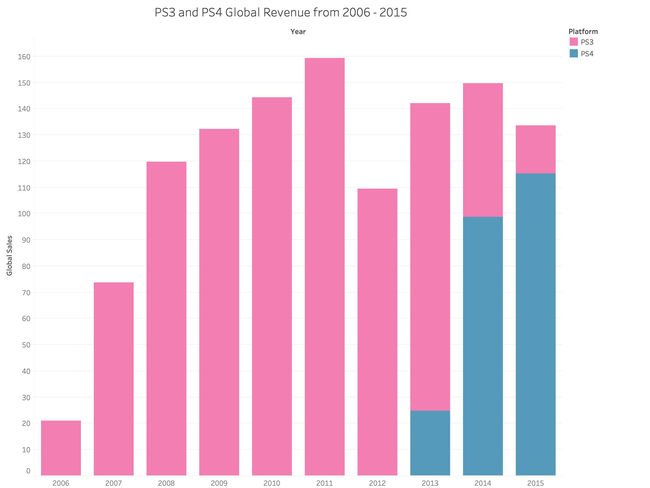
GLOBAL SALE TRANSITIONS FROM PS3 TO PS4
In 2013, Sony released its fourth iteration of the PlayStation.
Global sales per console stayed the similar, but revenue changed from PS3 to PS4

Slide 17
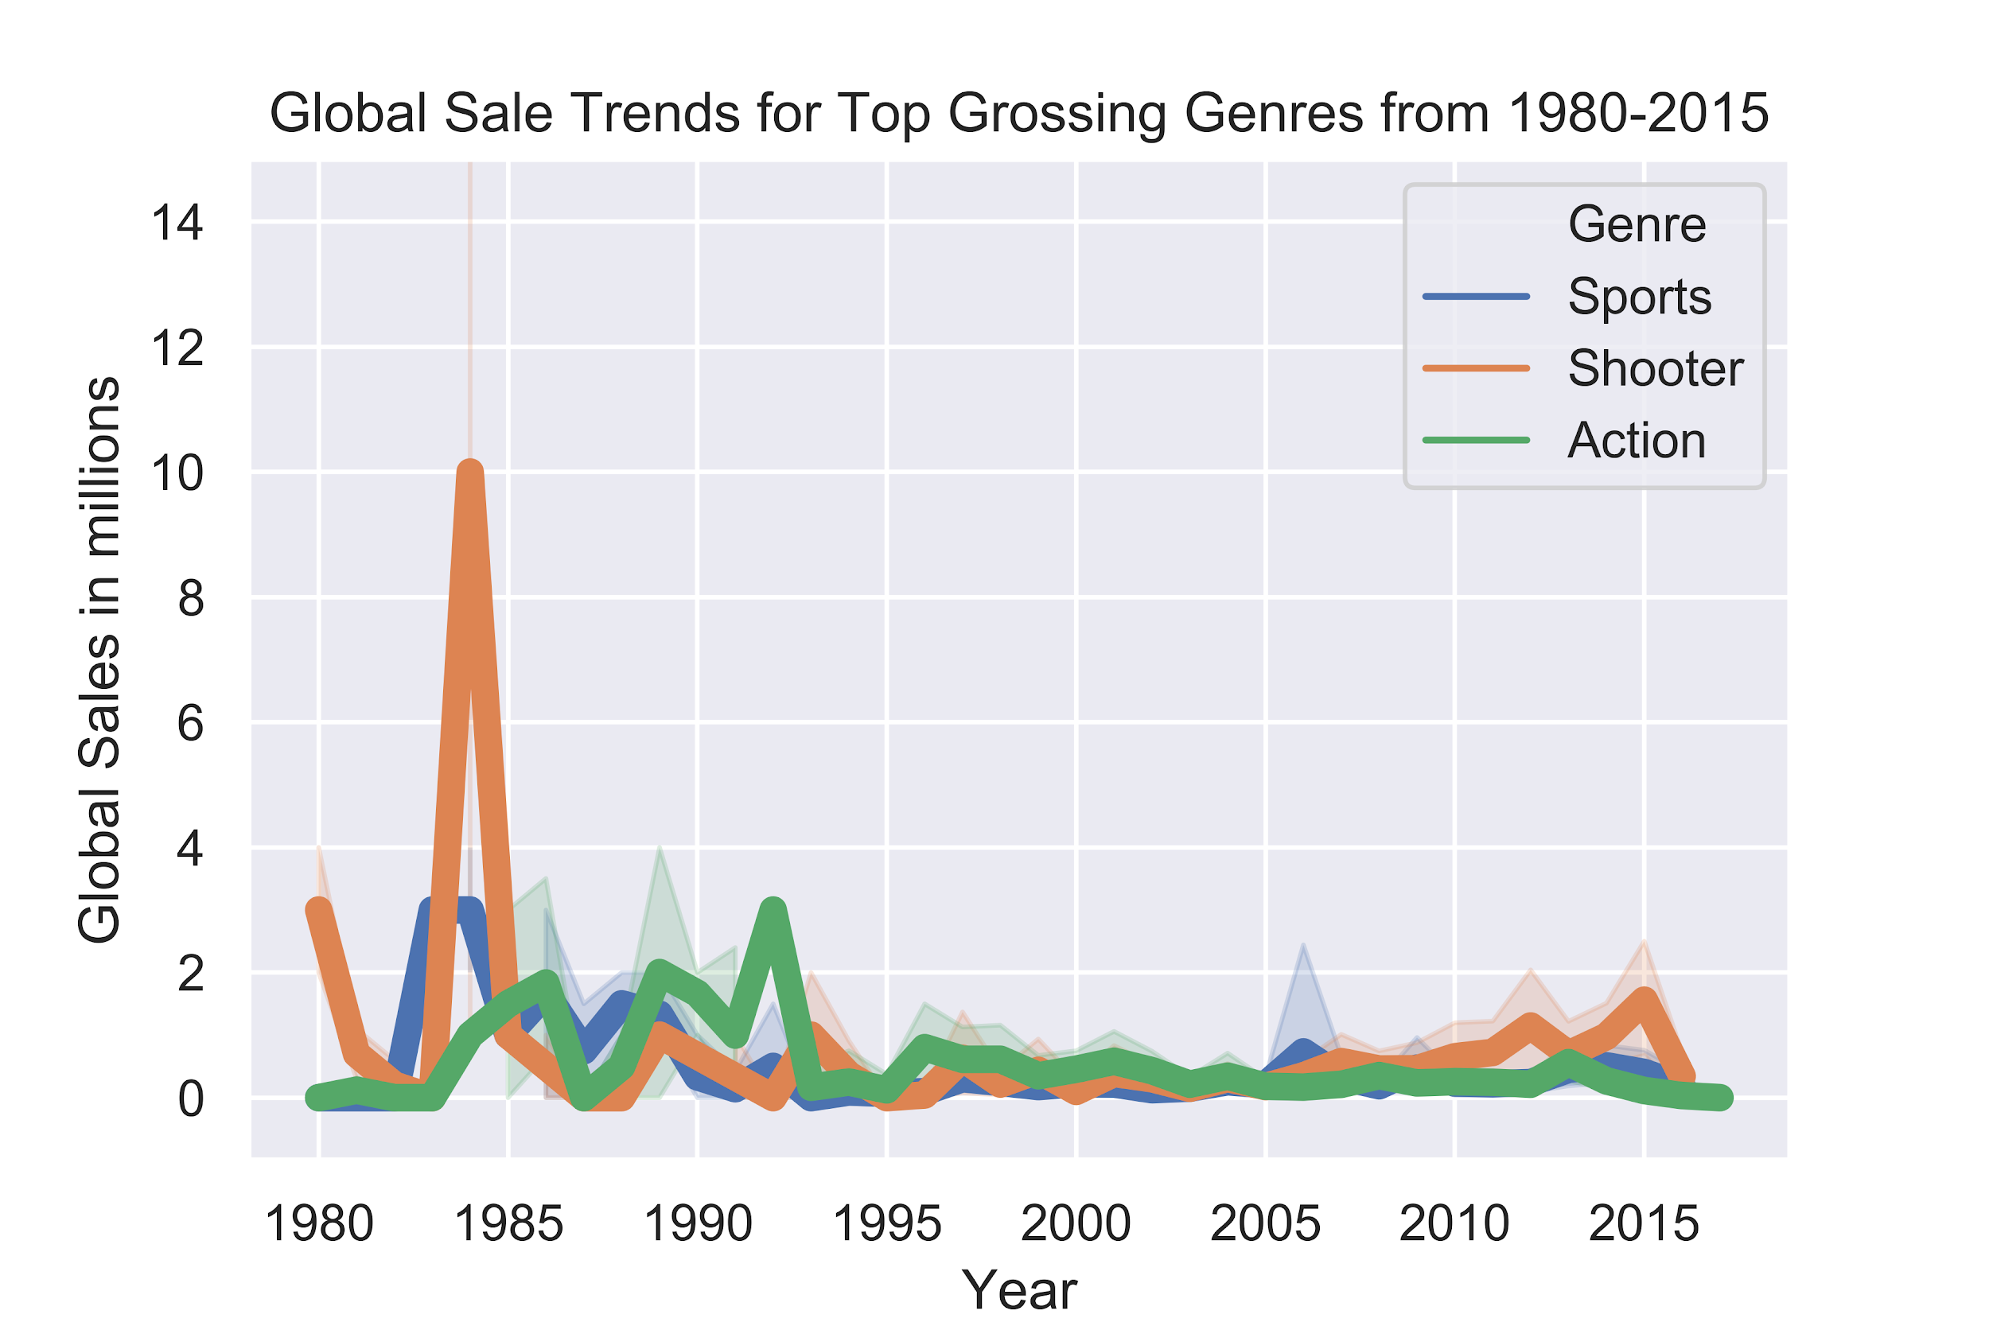
TOP GENRES
Genre trends are steady from 1980 to 2015, except for in 1984

Slide 18
$ 28,310,000
In April of 1984, Nintendo released one of its most famous games, Duck Hunt, grossing 28.3m in sales

Slide 19
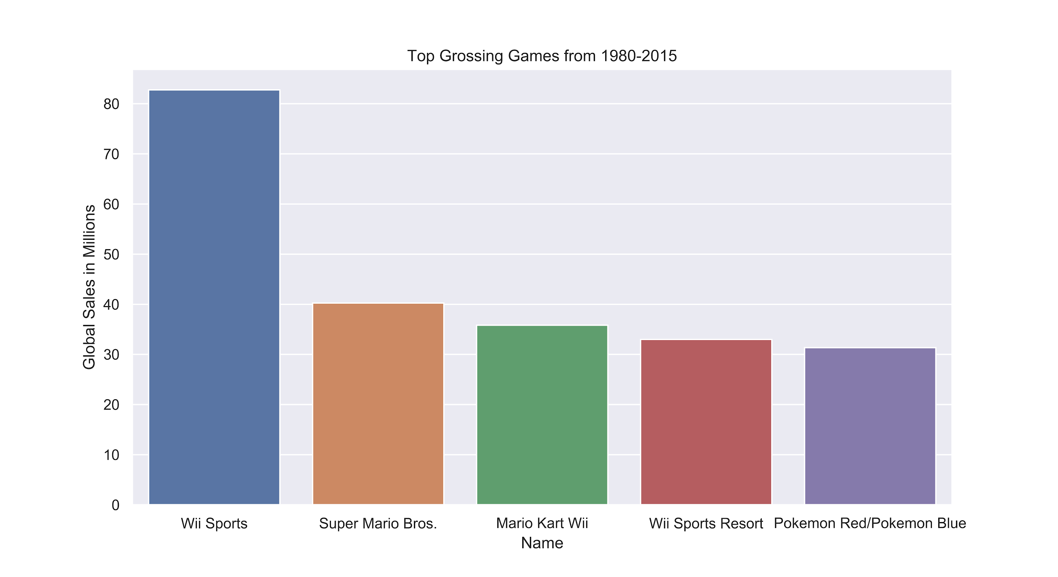
TOP GROSSING GAMES FROM 1980 - 2015
All the top grossing games are published by Nintendo, yet none of these games sold on Playstation or Xbox

Slide 20
$ 82,700,000
$ 40,240,000
$ 35,820,000
Wii Fit is king doubling sales of second place
In second, Super Mario Bros.
Mario Kart follows closely behind Super Mario Bros.

Slide 21
IMPROVEMENTS...
01
02
03
PYTHON
MatPlotLib
Tableau
Due to the dataset, there was limited analysis with simply game titles and sales. And some graphs should have had analysis
I couldn’t get the colors to match, and querying my dataframe got cumbersome if I didn’t specify what exactly was in the graph
Tableau seemed to never do what I wanted it to do, but it makes pretty graphs. Would have liked to analyzed numbers and percentages

Slide 22
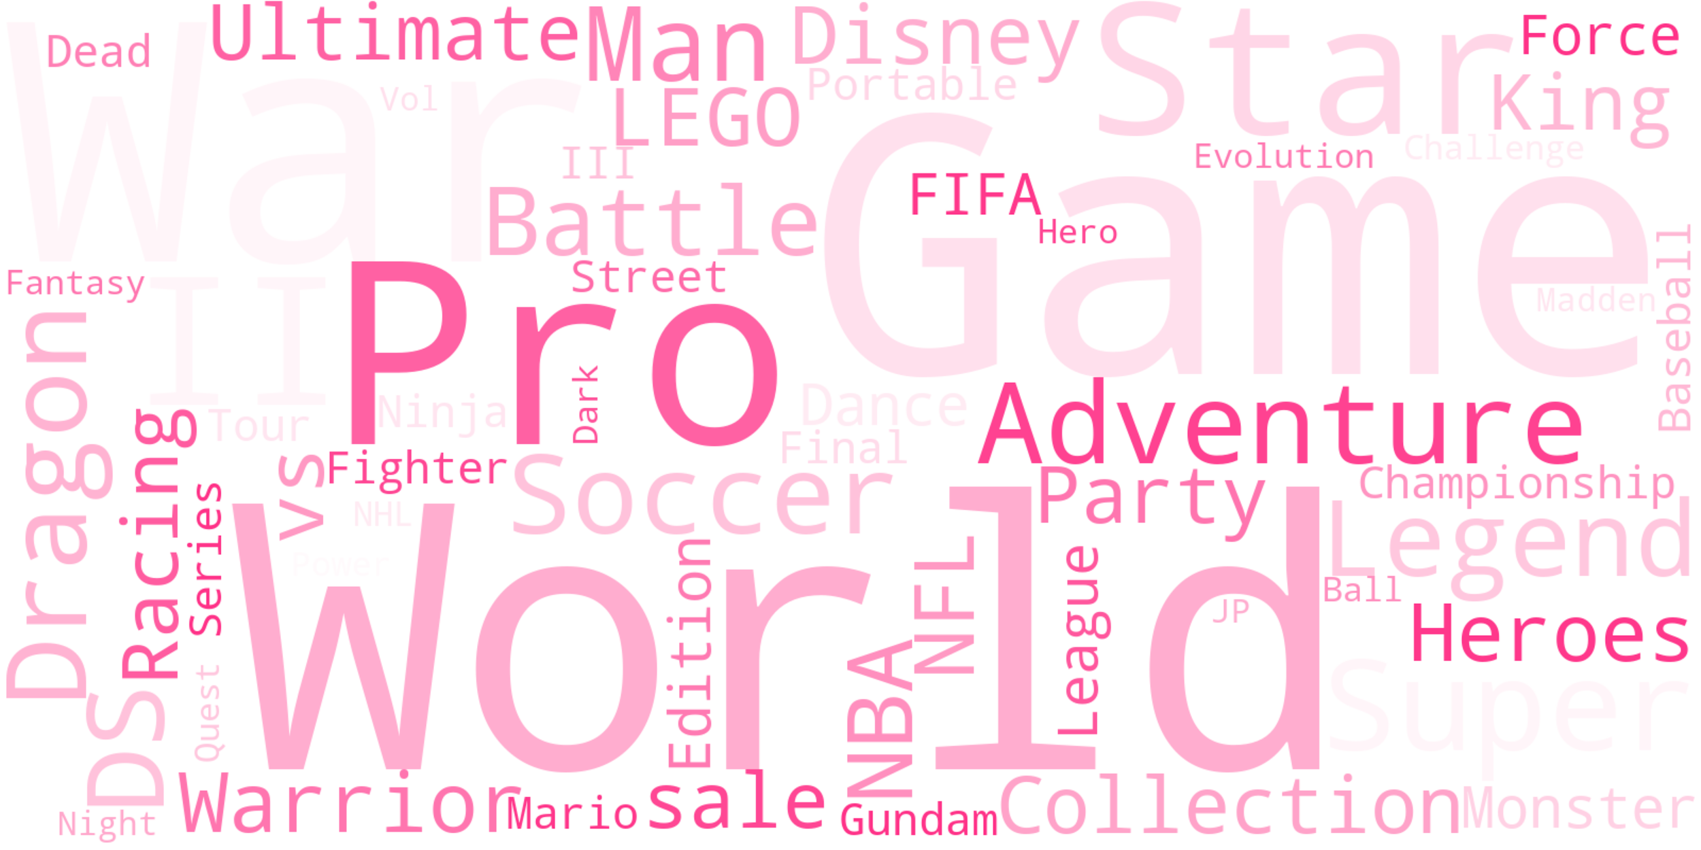
THANKS
v
IRON
HACK
Christopher Angeles

